Slide 1


Employment Inequalities and Immigration Status
Influences of Race, Language Proficiency, Gender, and Education Level
Mahjoube AmaniChakani, Nkasiobi Nwobi, Maya Krishnan, Ogochukwu Onyeso
March 12, 2025
IDEA GROUP 3

Slide 2
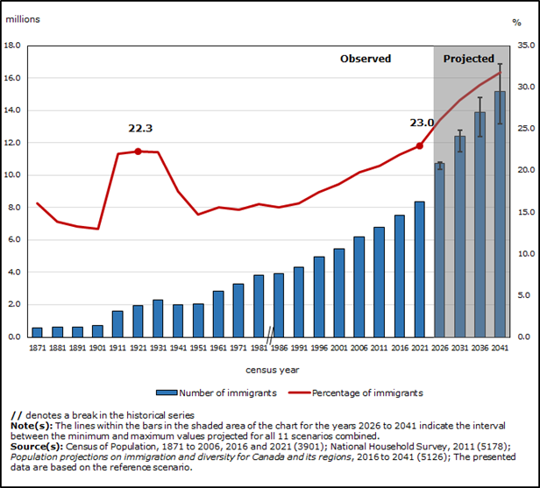
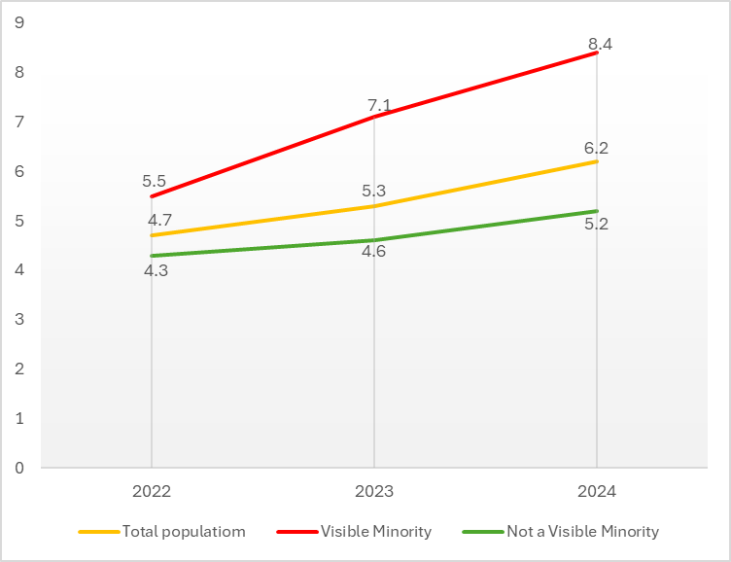
Project overview
Background: Canadian immigrants admitted as skilled workers.
Problem: Despite Canada’s commitment to diversity and employment equity, employment inequity and financial insecurity persist.
Research question: How does immigration status contribute to employment inequality in Canada, and how do race, language proficiency, gender, and education level shape this relationship?
Data: 2021 Canadian Census Public Use Microdata (PUMF)
Analysis:
Heat maps
Logistics regression

Slide 3
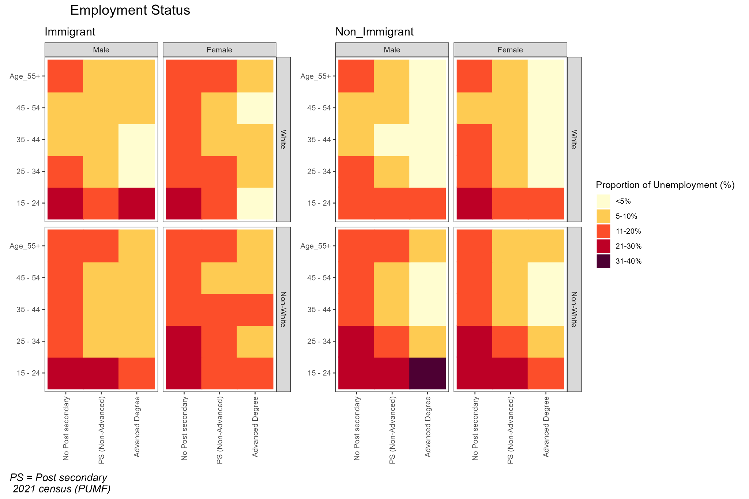
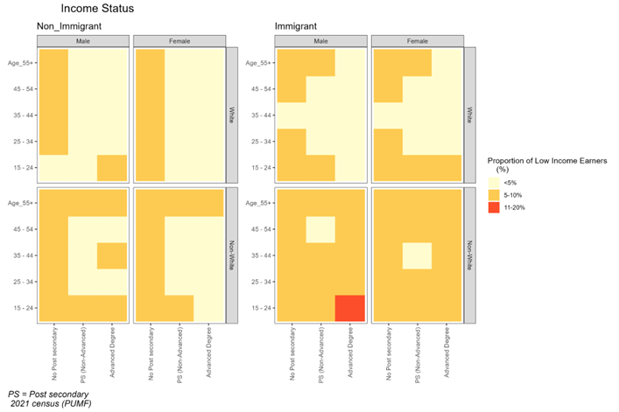
Results and discussion

Slide 4
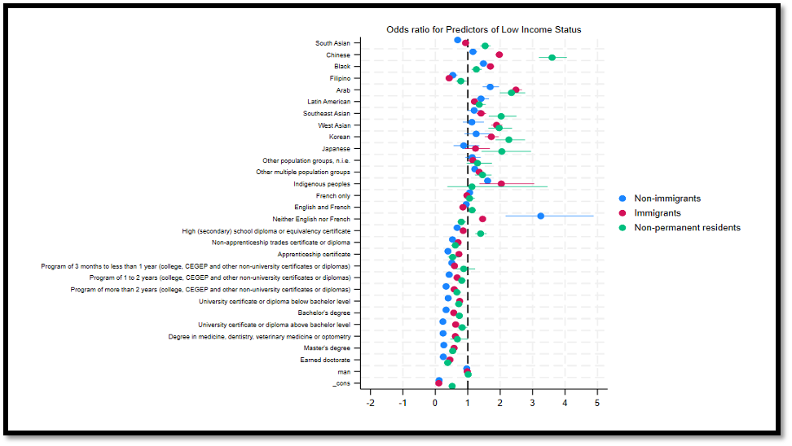
Results and discussion

Slide 5

Summary
Employment alone does not capture economic insecurity- racialized immigrant workers experience low income, precarious work conditions, and wage gaps.
Non-immigrant racialized groups face substantially higher odds of lower incomes compared to non-visible minorities
Persistent race-influenced economic inequality even for the Canadian-born.
Racial penalties are higher for immigrants (double disadvantage as both immigrants and racialized).
Black immigrants are particularly at high risk.
For non-PR, results are more varied, but South Asian and Black individuals face higher odds of low income.
Thanks for your attention
Recommendations!

